Slide 1
32-bit RISC-V CPU Design
Review and discussion session – August 27th 2023
Updates until August 27th:
RV32I (Integer) extension RISC-V ISA support
5 stage pipelined processor
Hazard detection and data forwarding
Modular and extensive design
Self-control logic on modules

Slide 2
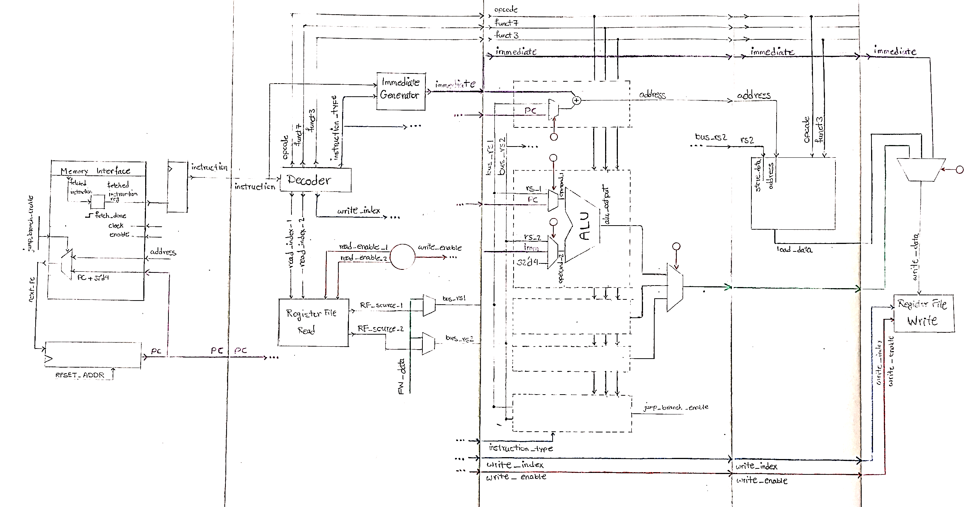
32-bit RISC-V CPU Design
Review and discussion session – August 27th 2023

Slide 3
Technical Specifications:
Module | Max Delay (ps)
Address Generator | 3844.84
Arithmetic Logic Unit | 3099.01
Control Status Registers | 747.689
Hazard Forward Unit | 1131.73
Immediate Generator | 1016.44
Instruction Decoder | 716.437
Jump Branch Unit | 243.115
Register File | -
Memory Interface (8 cells - Logic) | 265.648
Normalized Memory Access Time | 10000 - 40000
Fetch Unit (8 cells - Logic) | 308.907
Load Store Unit (8 cells - Logic) | 569.903
Total | 11678.071
Core specifications
Clock Cycle Time | 4 ns
Memory Operation Time | 3 clock cycles
CPI (R,I-TYPE) | 1.13
Frequency | 250MHz
Memory address space | 4KB

Slide 4
Self Control Logic:
Control Unit
ALU Control Logic
LSU Control Logic
Fetch Control Logic
…
ALU
LSU
Fetch
…

Slide 5
Self Control Logic:
Control Unit
ALU Control Logic
LSU Control Logic
Fetch Control Logic
…
ALU
LSU
Fetch
…
Control Logic
Control Logic
Control Logic

Slide 6


Testing processor and benchmarking:
There are 2 applications developed in Python for automation of core programming process. These code executant applications can be executed in both Windows and Linux environments.
Windows:
Venus Simulator (assembly code) “Visual Studio Code” extension
Test flow:
Assembly output (.txt) → Python Script → instruction memory HEX file → Testbench
Linux:
RISC-V GCC compiler toolchain (C code)
Test flow:
C code → Python script → Generated shell script to run C code by GCC toolchain
→ instruction memory HEX file → Testbench
0 1 0
1 0 1
0 0 1
C
HEX
(instruction memory)
ASM
testbench

Slide 7
To do list:
Run GCC compiler output HEX file on RV32I core
Add Multiplier Unit to core
Add Fixed-Point Unit to core
Run GCC compiler output HEX file on RV32IMF core
Run time analysis tests on final core
CPI calculation
Critical path and clock width calculation
Frequency calculation
Final report on core specifications
Documentation and publishing repository
Issues:
Standard synthetize and time analyze tool
Siliconcompiler out of reach (remote run not supported anymore)
Skywater130 and Nangate45 out of reach
Current tools: Yosys, Qflow
Non-standard technology (usu0.018)
Standard: Cadence, Synopsys

